Slide 1

QUANTUM COMPUTING

Slide 2

quantum computing
The quantum computing is based upon the quantum mechanics of an atom’s particles. The theory behind quantum computing is quantum theory of mechanics in which multiple states of a particle of an atom is used.

Slide 3
Quantum computing uses the quantum bit, precisely referred to as qubit, which is used as the basic unit of measuring the information or data in the quantum computing.
In the classical computing systems, a bit is used for measuring the information or data.
The bit is any one of the two states—either it is zero (0) or one (1).
But in qubit, there is another state other than 0 and 1 called superimposition state, which is the combination of both states of a particle used in the quantum computing.

Slide 4
Salient Features of Quantum Computing
It is a subfield of quantum information science, which is one of the major domains of the modern quantum physics
Different types of computing models are used in building quantum computers such as:
– Quantum Circuit model (mostly-used)
– Quantum Cellular Automata model
– Quantum Turing Machine model
– One-Way Quantum Computer model
– Adiabatic Quantum Computer Model.
Maintaining the states of qubits is very sophisticated and difficult process because the states of the qubit after applying certain physical processes are highly unstable and prone to high level of state fidelity.

Slide 5
Salient Features of Quantum Computing
Quantum computing is based on the principles of quantum mechanics in which the behavior and energy of particles are at atomic and subatomic levels.
The power of qubits increases exponentially with the addition of another qubit. Normally, the power of qubit is 2 n with additional qubit numbers (n) unlike the traditional computing in which the additional transistor adds the power linearly.
The hardware used in the quantum computers include superconductors and superfluid for maintaining and transporting the states of the particles within the quantum computer processors.

Slide 6
Short History of Quantum Computing
1985—Construction of quantum logical gates by David Deutsch of Oxford University for building the processor of universal quantum computer. He is also known as the father of the modern quantum computing systems.
1994—An algorithm to factorize numbers was built by Peter Shore.
1998—First 2-qubit computer was built by three pioneer engineers Isaac Chuang, Neil Gershenfeld and Mark Kubinec.
2000—A 7-qubit computer was developed by Emanuel Knill, Raymond Lalamme, and Rudy Martinez in the USA by using transcrotonic-acid.
2017—IBM announced the first quantum computer to be used commercially within the company’s network and partners.

Slide 7
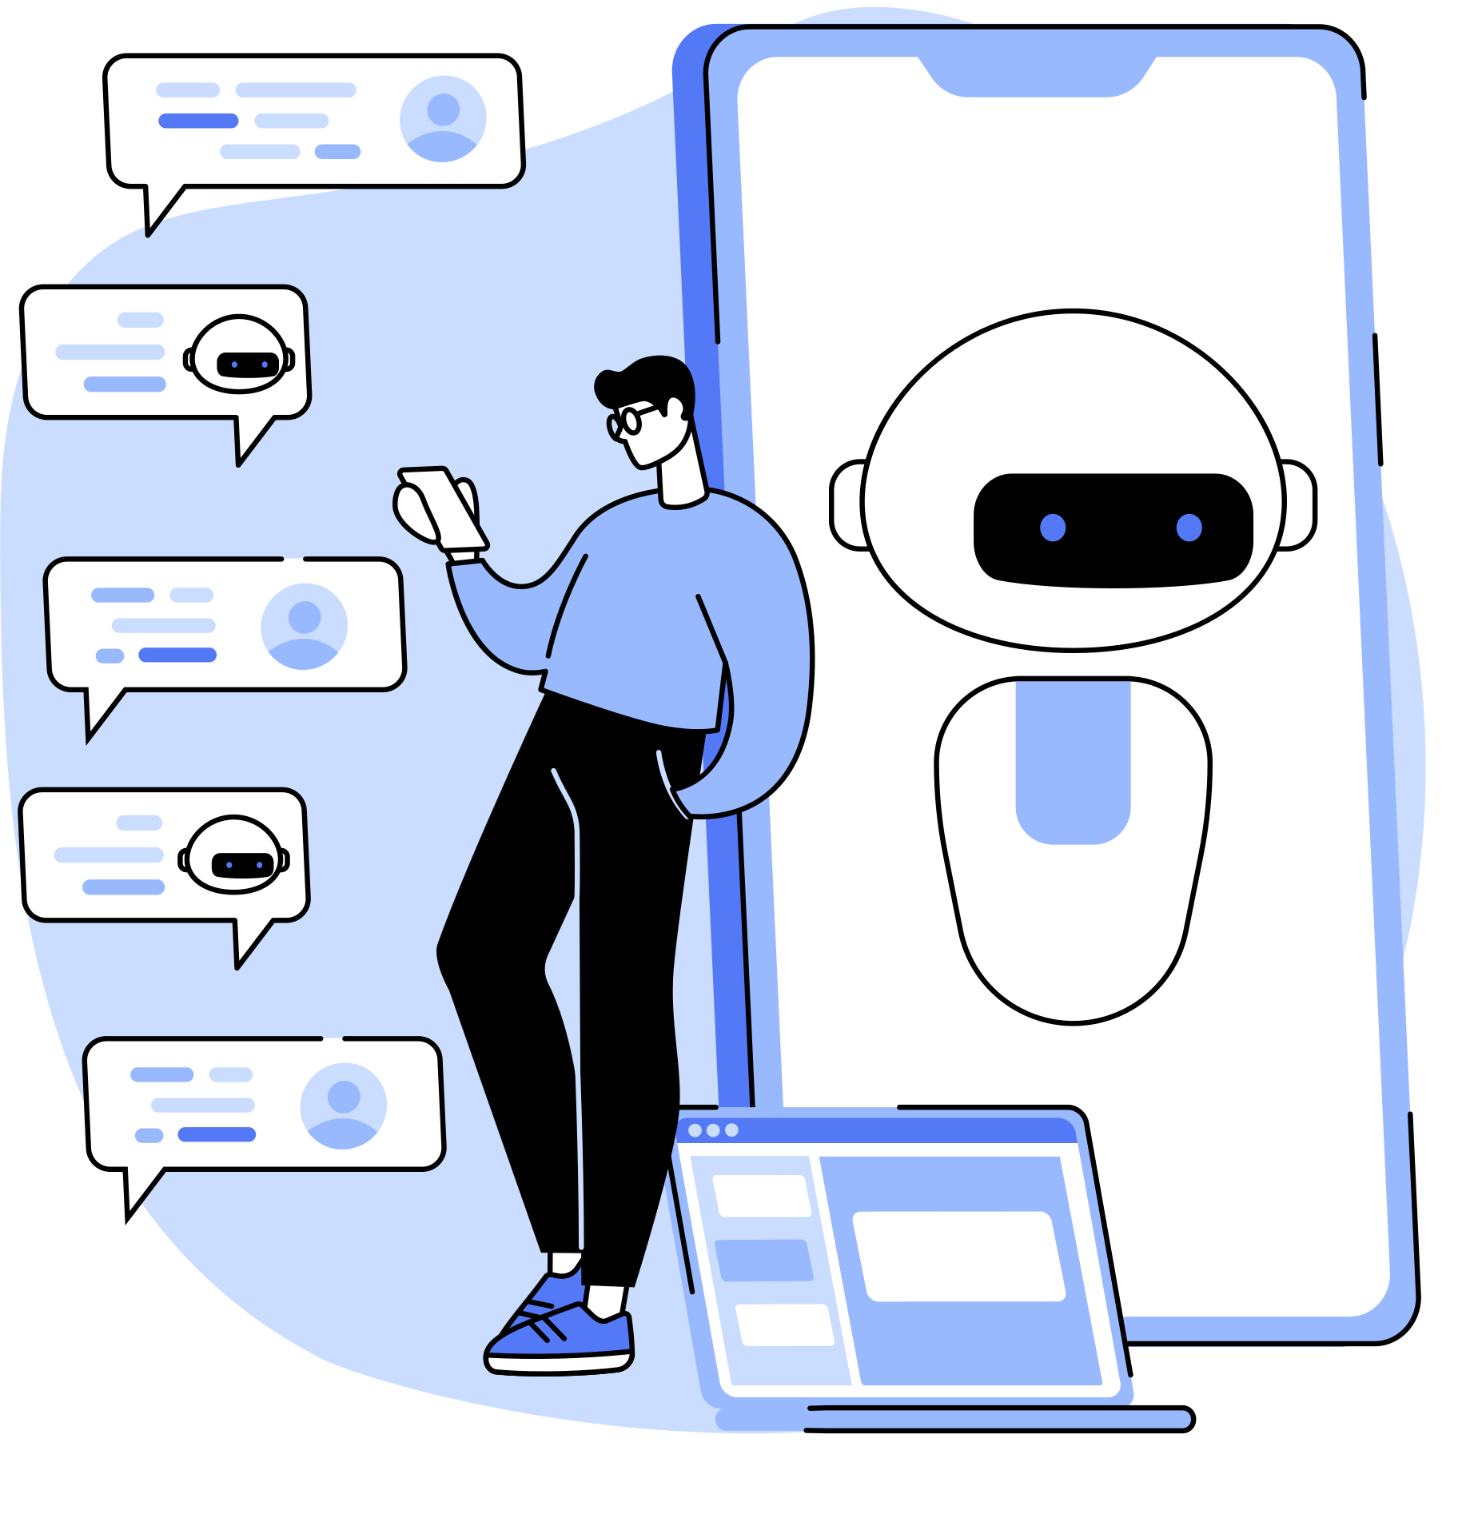
What Is Quantum Physics?
Quantum Physics deals with the smallest particles and units of matters and energy such as electrons, protons, neutrons, photons of light, waves, and their interrelationship. It provides the detailed insight into the microparticles of matters and energy.

Slide 8

Theory of Quantum Computing
The theory of quantum computing describes the implementation of the phenomena of quantum mechanics into digital computation for solving highly complex problems very fast.

Slide 9

Working Principle of Quantum Computing
The working principle of quantum computing is based on quantum mechanics theory that helps achieve multiple states of a particle under the effect of energy and mass simultaneously. A particle can exist under the influence of multiple mechanical processes such as electromagnetic waves, temperature, lipping, rotations, and others.

Slide 10

How Many States Are Used in Quantum Computing?
Theoretically speaking, the number of states that a quantum computer can handle is unlimited or infinite. The number of states is based on the qubit superposition conditions of a material used in the quantum computing.

Slide 11
superposition
The superposition is the combination of two distinct states of quantum particles to form a new state that describes the linear combination of those two distinct quantum states.

Slide 12
entanglement
In quantum physics, the entanglement is an important phenomenon described as the state of linking of two quantum particles present at any distance away from each other.

Slide 13

Difference Between Traditional Computing and Quantum Computing
Processing material
Data units
States of units
Scaling up
Suitability
Cost
Environments
Error rate
Operations

Slide 14

Real-World Quantum Applications
1
Healthcare applications
2
Cybersecurity
3
Artificial intelligence (AI)
4
Financial applications
5
Complex manufacturing
6
Telecommunication

Slide 15
Major Projects on Quantum Computing
1
IBM
2
Honeywell
3
Google
4
Microsoft

Slide 16
Superconductors
Superconductors are the materials in element or compound forms that offer practically zero resistance to current and there is no magnetic flux field available in the material.

Slide 17
SuperFluid
Superfluid is a physical state of a fluid under certain conditions when it lows without losing any kinetic energy due to its characteristics of zero viscosity.

Slide 18
Quantum Mechanics
Quantum mechanics is a sub-class or a branch of physics that deals with the behavior of very small physical particles at atomic or subatomic levels.

Slide 19
QUBITs
In quantum computing, qubit is also represented by a zero (0), a one (1) and a third state that is linear combination of both states.

Slide 20
quantum logic gate
Quantum logic gate, precisely referred to as quantum gate is physical analogous to the digital logic gate used in the classical computing systems. It is a model of quantum circuit building unit. In other words, it is the quantum circuit used in processing the qubit information in quantum computing systems.

Slide 21
quantum counting
The number of possible quantum solutions for a problem is called quantum counting. It is referred to as the efficiency counting of the quantum system too

Slide 22
grover’s algorithm
The Grover’s algorithm is a mechanism of finding out the solution to the problem in unstructured data quadratically. It is the second most powerful algorithm used in the quantum computing systems.

Slide 23
shor’s algorithm
Shor’s algorithm is a mechanism to find out the prime factors of an integer. The time taken to get the prime factors of an integer is about polynomial of the conventional computing time.

Slide 24
Josephson junction
Josephson junction is the combination of two superconducting material separated through a non-superconducting material to form a tunnel that can pass current without any need of an external source of energy.

Slide 25

THANK YOU FOR LISTENING!

